Slide 1

PHP and MySQL

Slide 2
Database
Create
Back up
Restore

Slide 3
Table
Create table with Fields and constraints.
Add record
Delete record
Update record

Slide 4
PHP and MYSQL
Establish the connection with the database.
Declare the SQL statement that you want to perform.
Prepare the SQL statement.
Bind the parameters with placeholders.
Execute the SQL Statement.
Close the connection.

Slide 5
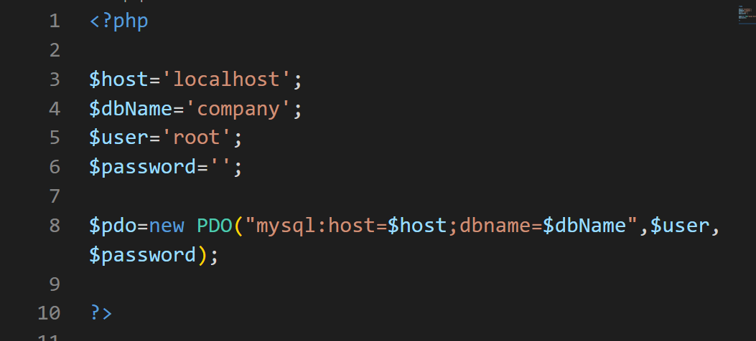
PHP and MySQL
1- Connect
http://localhost/php-pdo/db/connect.php

Slide 6
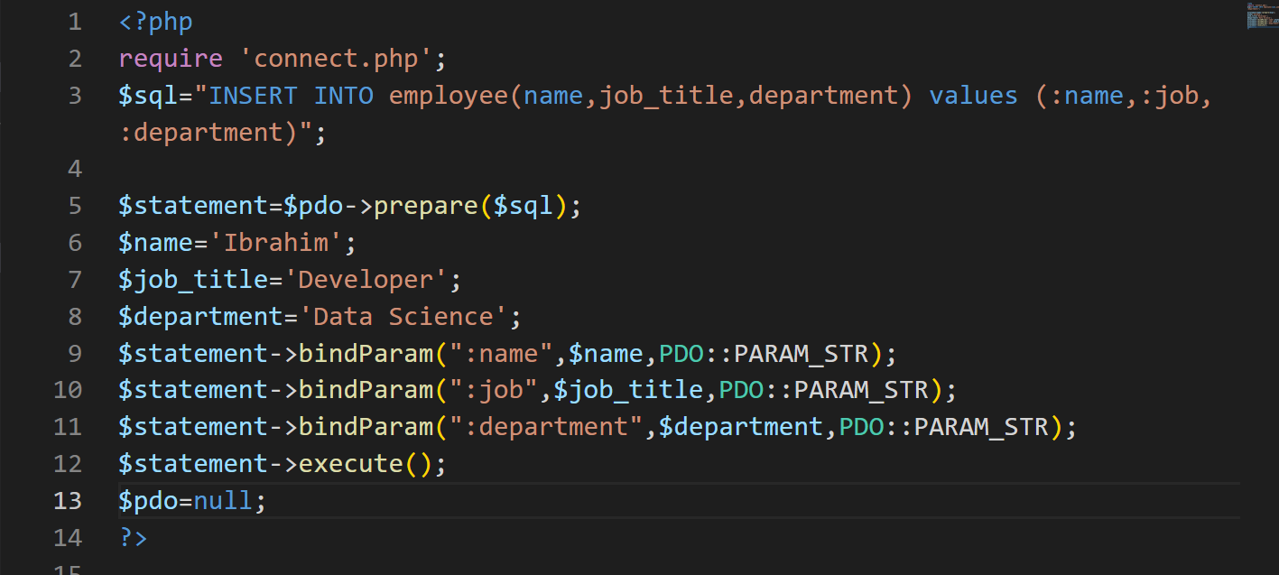
PHP and MySQL
2- insert Records
http://localhost/php-pdo/db/insert.php

Slide 7
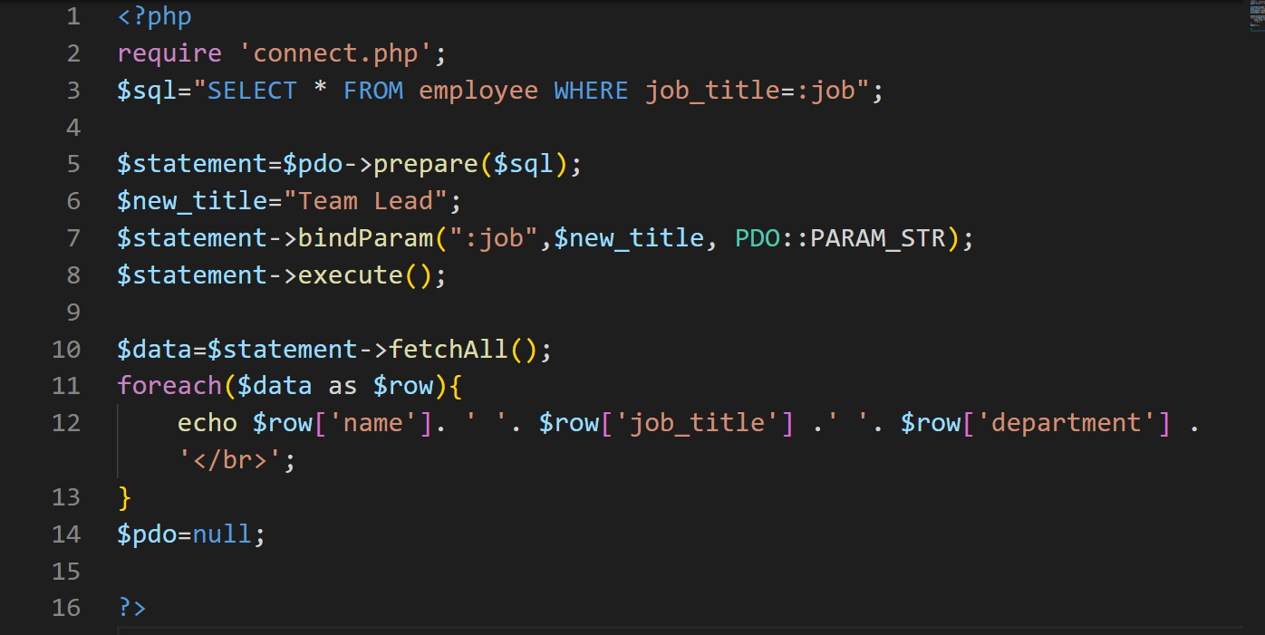
PHP and MySQL
3- read Records
http://localhost/php-pdo/db/select.php

Slide 8
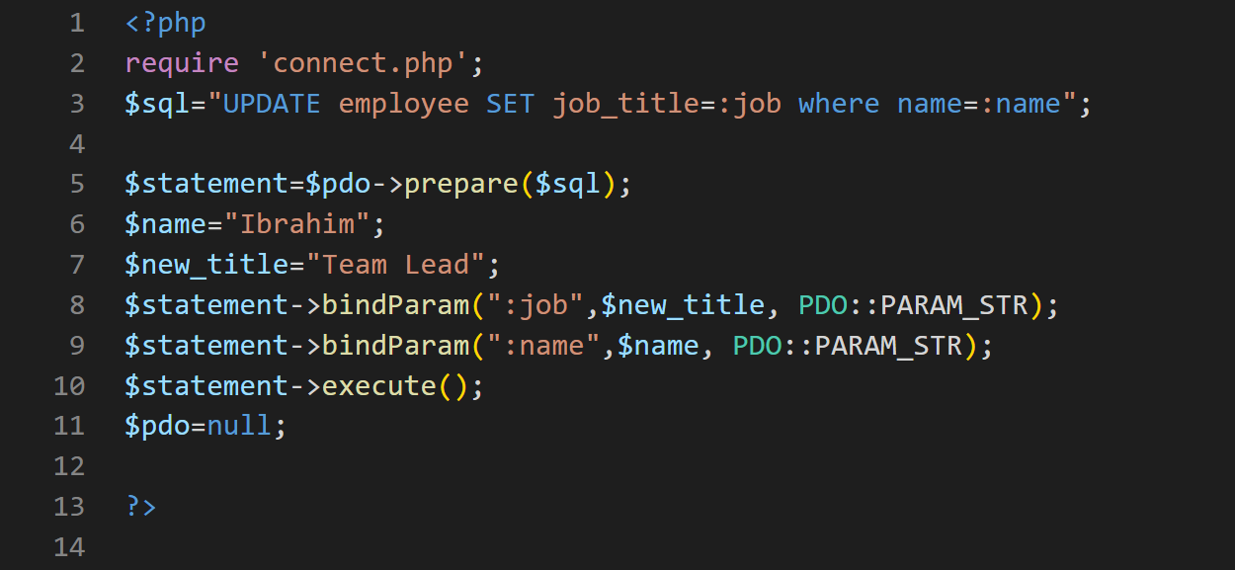
PHP and MySQL
4- Update Records
http://localhost/php-pdo/db/update.php

Slide 9
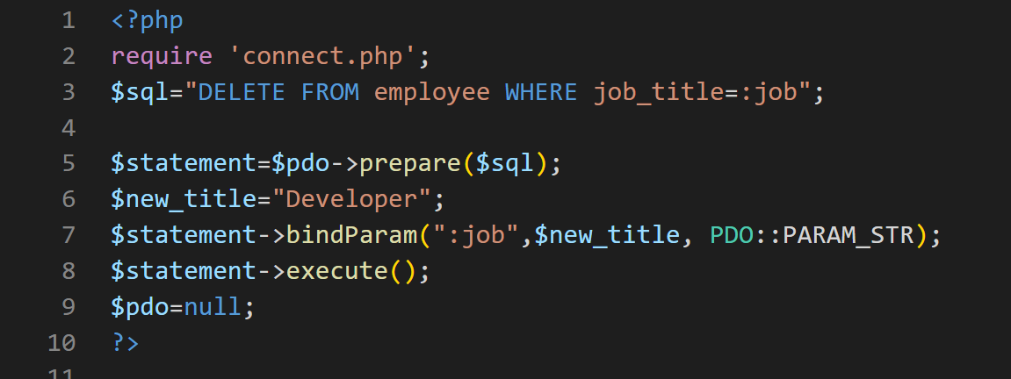
PHP and MySQL
5- Delete Records
http://localhost/php-pdo/db/delete.php

